Slide 1
Abstract Automata Learning
Kudos to various sources for sharing their slides

Slide 2
Reminder

Slide 3
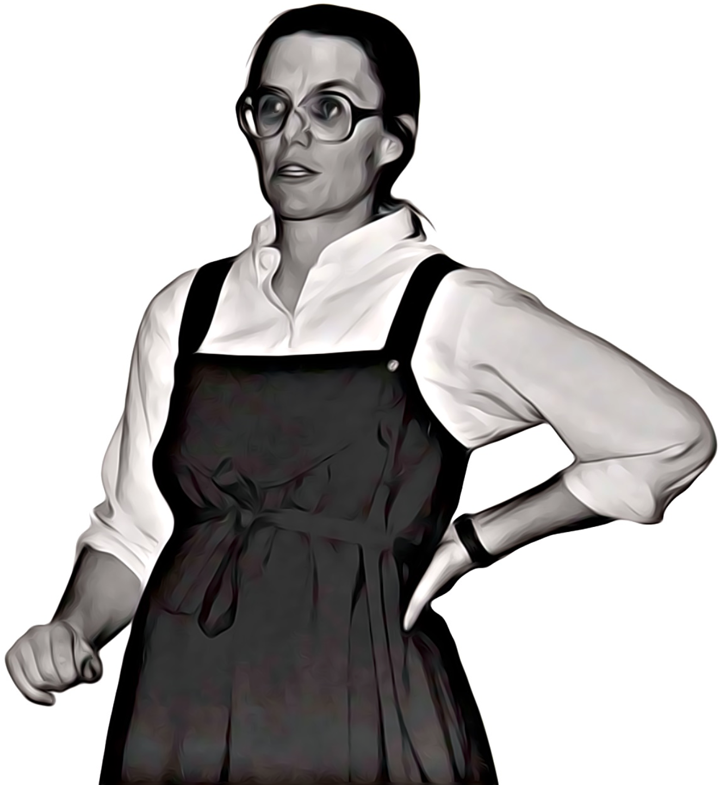
Active Learning

Slide 4

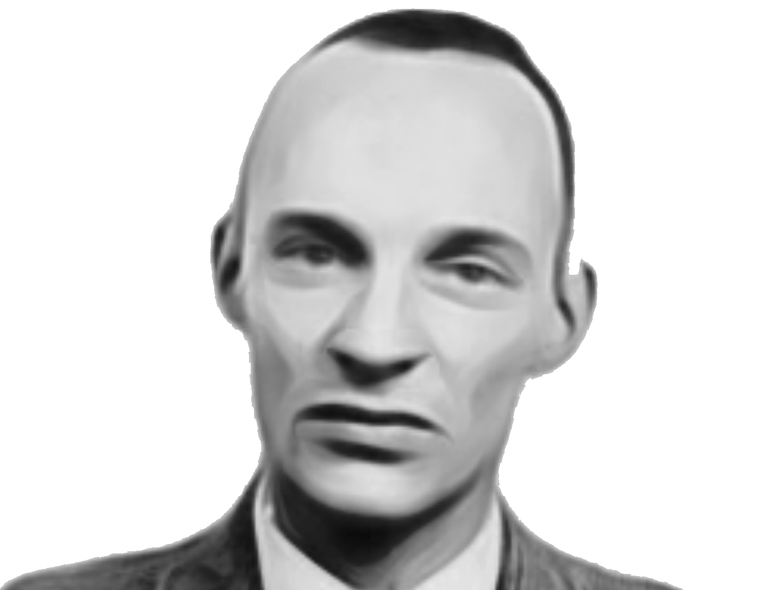
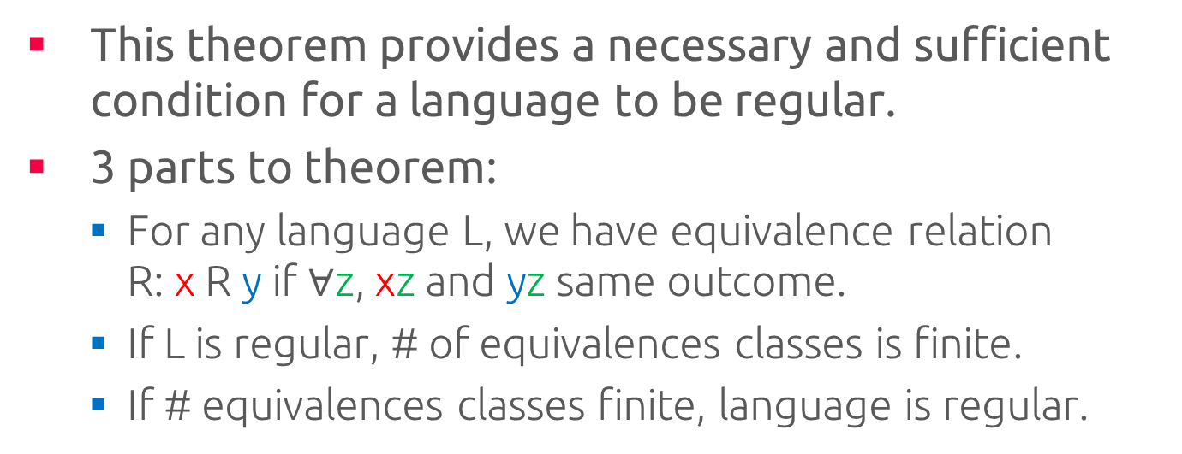
Myhill-Nerode Theorem
This theorem provides a necessary and sufficient condition for a language to be regular.
3 parts to theorem:
For any language L, we have equivalence relation R: x R y if $∀$z, xz and yz same outcome.
If L is regular, # of equivalences classes is finite.
If # equivalences classes finite, language is regular.

Slide 5
Motivation
Why do we do automata learning?

Slide 6
White-Box vs. Black-Box
White-box
We can inspect its execution paths
Source code
Black-box
Conceals parts of execution paths
IP-cores, hardware components, …
Known interface
How else we can use a 3rd party library?
Symbolic Execution?
Implement black-box behavior (µClibc)

Slide 7
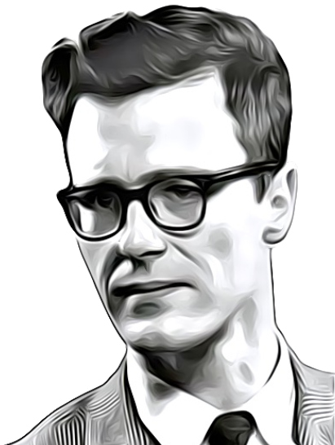

Testing vs. Verification of Black-Boxes
Testing
“can only find bugs, not prove their absence”
— Edsger W. Dijkstra
Verification (Exhaustive Testing, Model Checking)
proves absence of bugs!
Verification Rocks,
Testing Sucks.

Slide 8
Model Checking Enabling Technology
Test Cases + Coverage
Programing Languages
void add(Object o) {
buffer[head] = o;
head = (head+1)%size;
}
Object take() {
…
tail=(tail+1)%size;
return buffer[tail];
}
Abstract
Automata
Learning
Model Checking
CEX / No Bug
Possibly Infinite state
Black-Box
Systematic state-space exploration

Slide 9
Abstraction
Abstraction therefore solves two problems
Enables Model Checkers to deal with software
Cuts the state space size
Abstraction comes in three flavors
Over-approximations
Under-approximations
Precise abstractions

Slide 10
Under-Approximation (“Meat-Axe” Abstraction)
Remove “irrelevant” parts of program w.r.t. property
Integer ↦ [0,10]
Unbounded Queue ↦ Queue of size 3, etc.
The abstraction of choice in the early days of software model checking
Typically manual, with no guarantee that the right behaviors are removed

Slide 11
Precise Abstraction
“Program slicing”
Automated under-approximation
Leads to a precise abstraction w.r.t. the property
int i;
int sum = 0;
int product = 1;
int w = 7;
for (i = 1; i < N; ++i)
{
sum = sum + i + w;
product = product * i;
}
write(sum);
write(product);
int i;
int sum = 0;
int product = 1;
int w = 7;
for (i = 1; i < N; ++i)
{
sum = sum + i + w;
product = product * i;
}
write(sum);
write(product);
Keep
(write(sum), sum)

Slide 12
Over-Approximation ^{(Abstract Interpretation)}
Maps sets of concrete states to one abstract state
Reduces the number of states
Increases the number of possible transitions
Rarely leads to a precise abstraction

Slide 13
Over-Approximation ^{(Abstract Interpretation)}
Example: Type-based abstractions
integer ↦ Signs abstraction {neg,pos,zero}
Eliminating spurious errors is the big problem
More transitions means more behaviors
Abstraction Refinement
Elimination of spurious errors
Refine the abstract state by splitting/merging
Abstract program has more behaviors; therefore, is an error in the abstract program, also an error in the original program?

Slide 14
Testing vs. Model Checking ^{(revisited)}
Testing:
Checks some executions
May miss errors
Model Checking:
Automatically combines behavior of state machines
Exhaustive and systematic exploring of all executions
Handles millions of combinations – hard to perform by humans
Reports errors as traces
OK
FSM
Software Testing
error
FSM
OK
Model Checking
error trace
specification
Line 5: …
Line 12: …
…
Line 41:…
Line 47:…

Slide 15
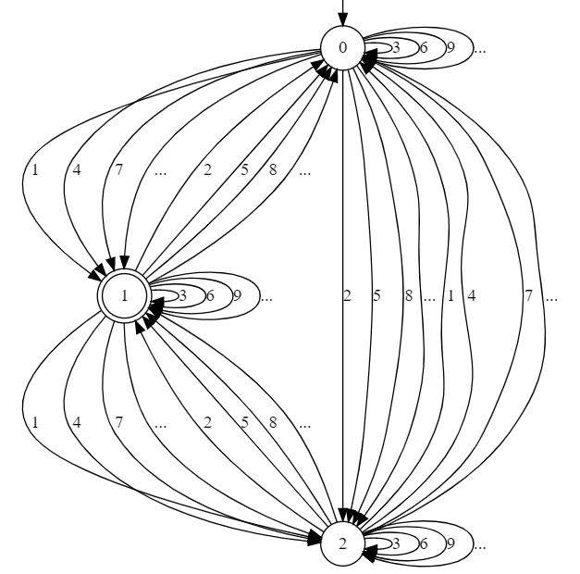
Concrete Automaton 1

Slide 16
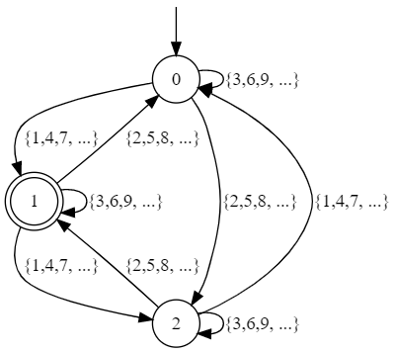
Concrete Automaton 1 ^{(contd.)}

Slide 17
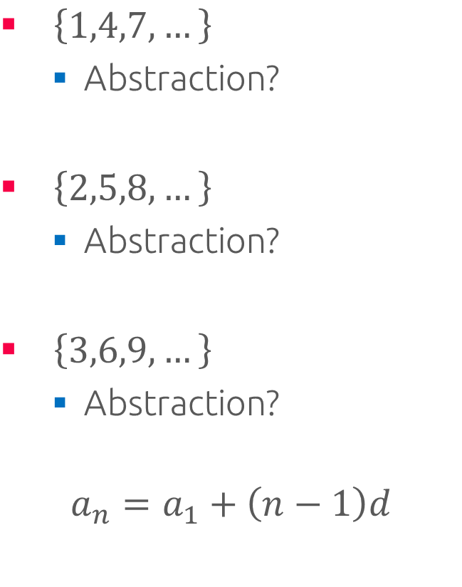
Abstraction Function?
$\left\{1,4,7,…\right\}$
Abstraction?
$\left\{2,5,8,…\right\}$
Abstraction?
$\left\{3,6,9,…\right\}$
Abstraction?
$$a_{n}=a_{1}+\left(n−1\right)d$$

Slide 18
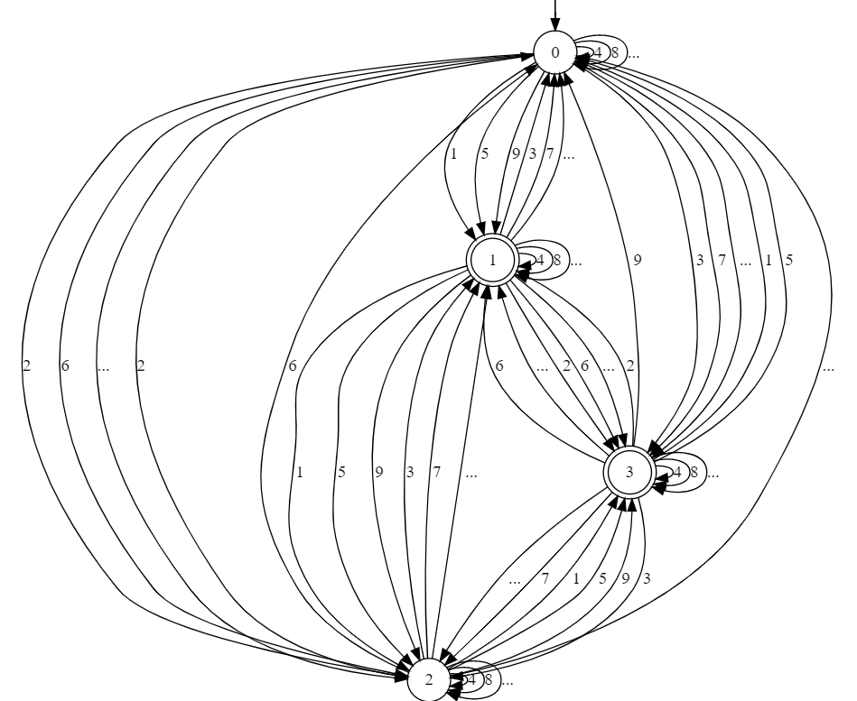
Concrete Automaton 2

Slide 19
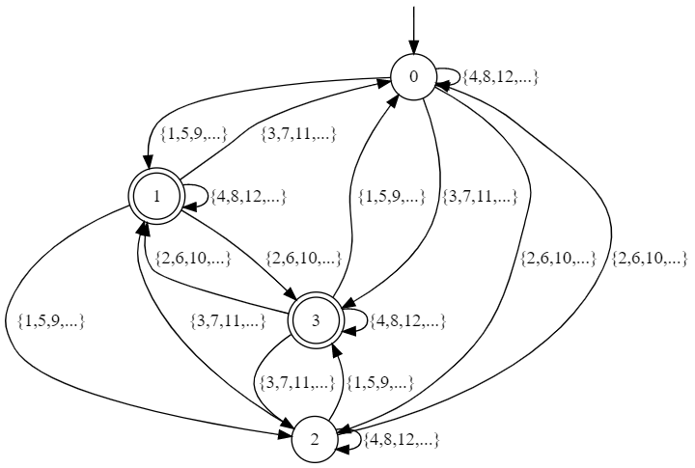
Concrete Automaton 2 ^{(contd.)}

Slide 20

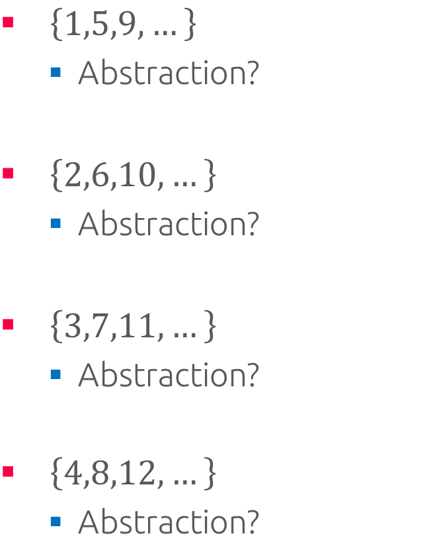
Abstraction Function?
$\left\{1,5,9,…\right\}$
Abstraction?
$\left\{2,6,10,…\right\}$
Abstraction?
$\left\{3,7,11,…\right\}$
Abstraction?
$\left\{4,8,12,…\right\}$
Abstraction?

Slide 21
Active Automata Learning ^{revisited}

Slide 22

Practical Active Automata Learning

Slide 23


Abstract Automata Learning

